Slide 1
Hydro-Bandaid
Nakyung Lee, Qingyuan Liu, Ayako Ohoka, Arushi Sardana, Aaron Schwartz-Duval, Veronika Sowers

Slide 2
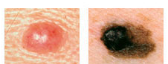
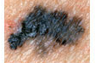
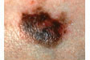
Melanoma
Most dangerous form of skin cancer originating from the pigment-producing melanocytes in the bottom layer of the epidermis
What it is
Unrepaired DNA damage to skin cells (usually from ultraviolet radiation) → genetic mutations → skin cells multiply rapidly
Causes
ABCDEs of melanoma - asymmetry, border, color, diameter, evolving
Biopsy
Diagnosis
Notes:
http://www.skincancer.org/skin-cancer-information/melanoma#panel1-1
http://www.mayoclinic.org/diseases-conditions/melanoma/basics/tests-diagnosis/con-20026009

Slide 3
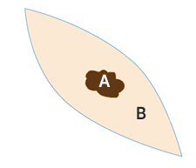
Stages and Current Treatments
Stage 0 (in situ) | Melanoma only in top surface layer of epidermis Has not metastasized | Wide-local excision surgery
Stage 1 | Melanoma less than 2 mm thick Has not metastasized | Wide-local excision surgery
Stage 2 | Melanoma between 1 mm and around ~4 mm thick Has not metastasized | Wide-local excision surgery
Skin cancer and a small margin of healthy tissue around it is cut out
Edges of wound are sutured
Tissue sent to pathologist for processing and margin evaluation
Recovery rate depends on size and site of cancer
Notes:
http://www.cancerresearchuk.org/about-cancer/type/melanoma/treatment/stages-of-melanoma
Combination therapies
Biological therapy
Chemotherapy
Radiotherapy
Surgery
Newer treatment options -- clinical trials
stage 3 and 4 have generally metastasized so wide excision surgery is not as common and instead a combination of therapies will be performed (such as radiation and chemotherapy)
https://www.asds.net/Wide-local-Excision-for-Skin-Cancer/
Metastasized- spread to nearby lymph nodes and/or other body parts (usually liver, lung, or brains)
Picture - http://www.melanoma.org.au/understanding-melanoma/treatment-options/
since it requires removal of health skin, the wounds can sometimes be very large and it can be hard to suture the wound edges back together
recovery rate varies greatly depending on size and site of the cancer (head and scalp usually take longer)
A = tumor
B = healthy skin taken out, in football shaped ellipse, and B depends on thickness of tumor

Slide 4
Significance
Melanoma
~73,870 diagnosed in 2015
~9,940 deaths in 2015
Incidence of melanoma has been increasing for the past 30 years
Recurrence occurs 10 or more years after initial treatment in more than 1 in 20 patients
Surgical Site Infection
3 in every 100 patients who have surgery develop a surgical site infection
Most common health-associated infection
~157,500 occurrences a year
98,987 deaths by healthcare associated infection in 2002
Notes:
statistics : http://www.cancer.net/cancer-types/melanoma/statistics
deaths due to post operative infections
number of melanoma surgeries
http://www.cdc.gov/HAI/surveillance/
http://www.cdc.gov/HAI/pdfs/ssi/SSI_tagged.pdf
diarrhea, vomiting, abdominal cramps
Injection site reactions and phlebitis
procedure picture: https://www.scripps.org/articles/2682-skin-graft
real life picture: http://www.woundsinternational.com/media/issues/231/files/content_196.pdf
after wide excision surgery
http://www.cancerresearchuk.org/about-cancer/type/melanoma/treatment/surgery-for-melanoma
infection can lead to inflammation of veins and blood clotting
https://www.facs.org/media/press%20releases/jacs/melanoma0613
http://www.melanomafoundation.org/facts/statistics.htm

Slide 5
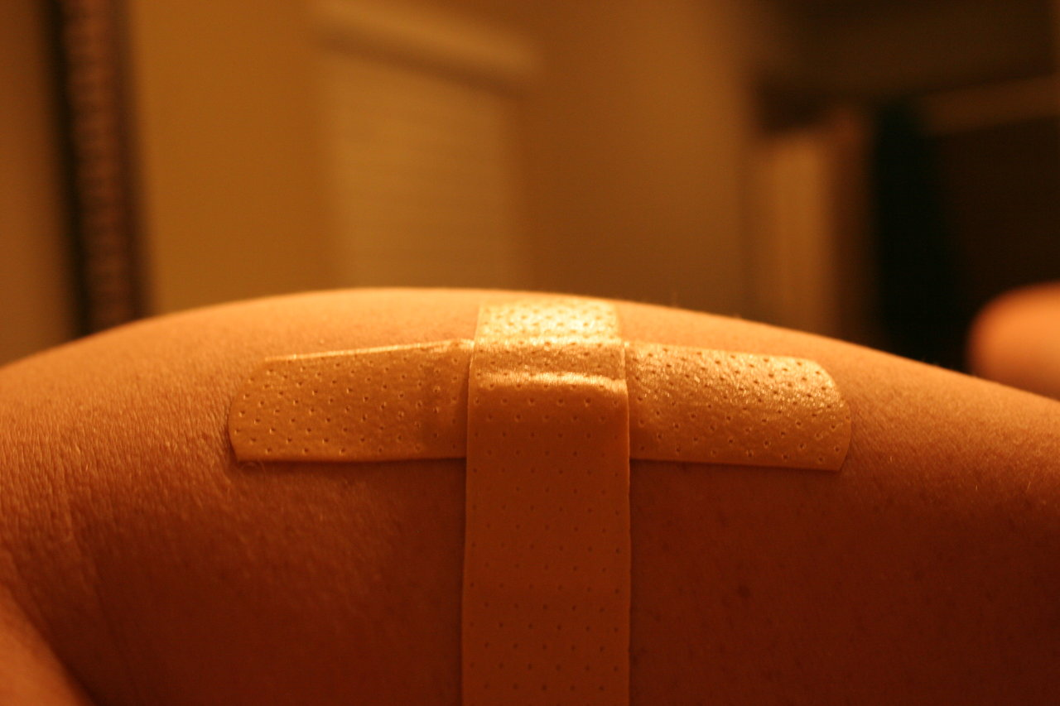
Our Approach: Hydro-Bandaid
Focusing on patient recovery post wide-local excision surgery
Sticky degradable hydrogel patch with microneedle for diffusion into skin
Layered assembly of alternating hydrogels with environmentally sensitive structure
Offers controlled release of therapeutics
Imiquimod- prevents recurrence
Antibiotics- prevents infection
Interferon- boosts immune system
Anticoagulants- prevents blood-clotting
Notes:
some stats on recurrence

Slide 6
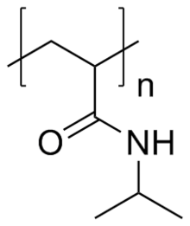
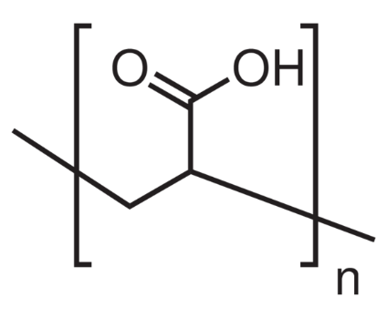
Temperature and pH Dependance
poly(n-isopropylacrylamide) – Temperature Sensitive
Modifiable with cellulose
Skin~34°C, Internal Body Temp=37°C
poly(acrylic acid) – pH Sensitive
Modifiable with cellulose
Skin~5.5, Blood=7.4, Tumor=6.0-6.8

Slide 7
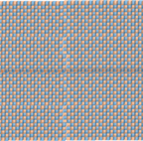
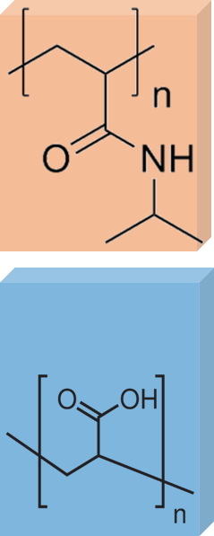
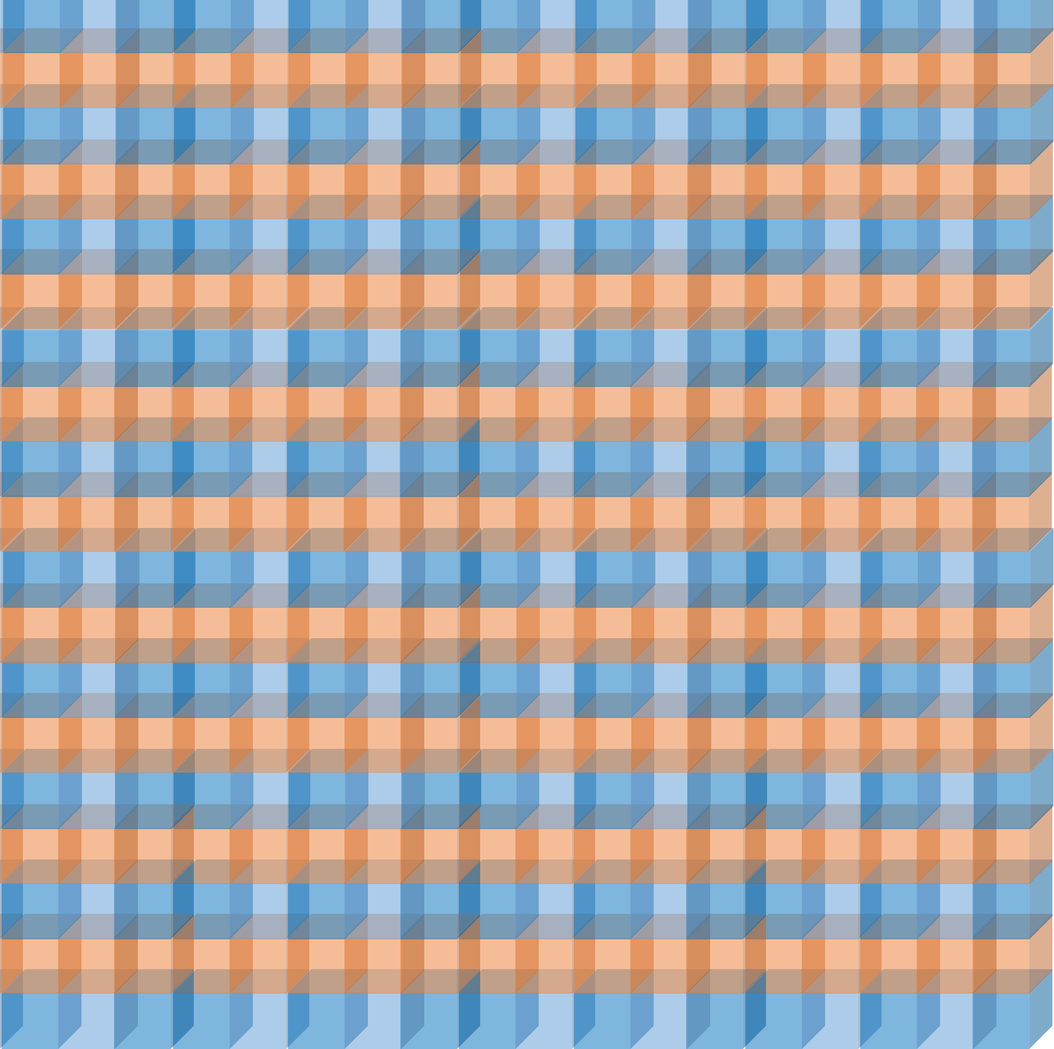
Layered Assembly versus Hybrid Gel
Hybrid Gel
Uneven dissolution/ release of therapeutic
Non-uniform diffusion gradient of heat and protons
Layered Assembly
Each layer provides “insulation” against the affector of the next layer
Superior control for directional release through two mechanisms
Separate tunable distinct modes of release for each layer

Slide 8
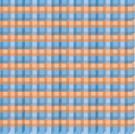

Thick versus Thin Layered Assembly
Thin layers will result in a more stable release of therapeutic, but the “insulation effect” will be diminished
Concentration
Thick layers will result in a more pulsatile release of therapeutic → controlled therapeutic release
Concentration
Time

Slide 9
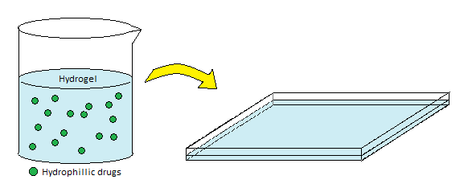
Fabrication / Methods
Hydrogel Sheet
(in large scale)
Hydrogel can be prepared in large-scale sheets → Mass production possible
Cut into desired size using x-y directional laser cutter
Notes:
Nakyung
*Reference for gif: http://www.makeblock.cc/xy-plotter-robot-kit/ *
Hydrogel pre-mixture + water with hydrophilic drug molecules -> poured into large sheet -> cut into small pieces with laser cutter
*Maybe the hydrogels can be in fish shape.. you know, for kids… *

Slide 10
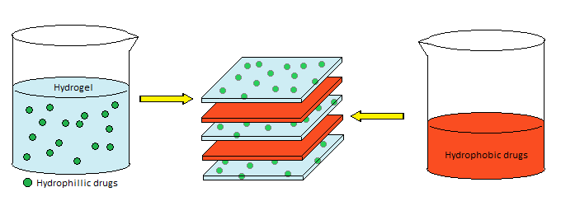
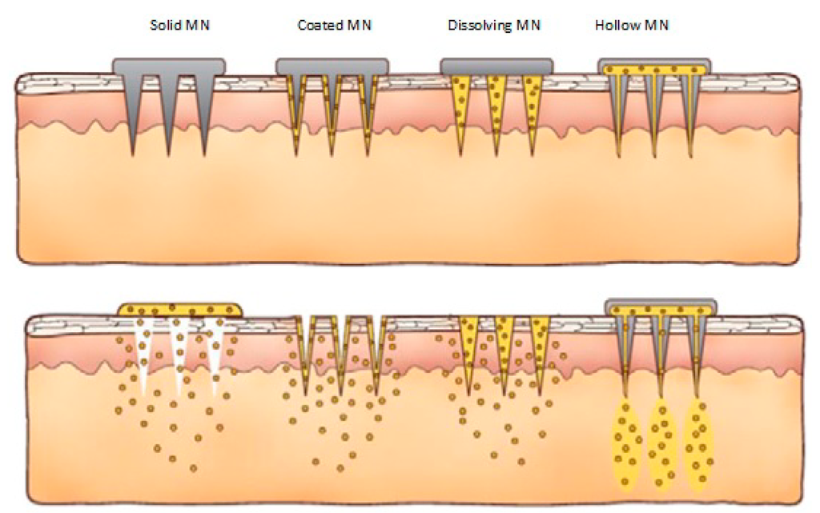
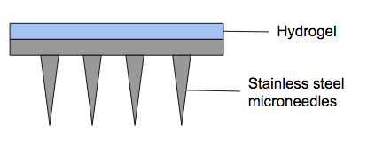
Fabrication / Methods
Layers of hydrogel and drug stacked up
Hydrogel with drug incorporated in goes on top of the metal micro-needle
Painless microneedles
Stainless steel
Notes:
Nakyung
*Reference for microneedle picture: http://www.mdpi.com/1999-4923/7/3/90/htm*
Erosion can actually enhance drug release due to acidic environment it induces.
Hydrophoic drugs applied on hydrogel surface -> dried -> another hydrogel layer -> hydrophobic drug dried -> ..(repeat)

Slide 11
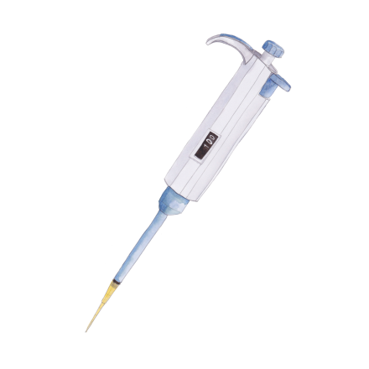

Testing: Material
Physical Characterization
Strip extensiometry
Compression
- Tensile modulus
SEM
Drug Release
Beaker containing 37˚C pH 5.5 citrate buffer covered by dialysis membrane
Read drug concentration in the solution overtime with UV/V is over various timepoints
Notes:
http://www.oulu.fi/spareparts/ebook_topics_in_t_e_vol4/abstracts/ahearne.pdf
http://www.mdpi.com/1996-1944/8/2/799/htm

Slide 12
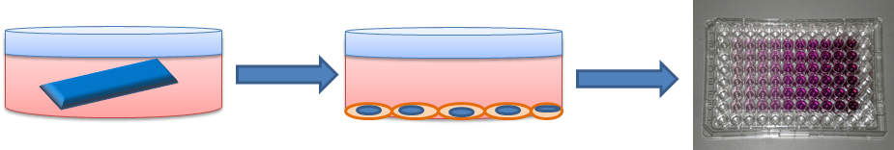
Testing: In vitro
Direct Contact Test:
Place hydrogels in well plate containing PCS-201-012 human dermal epithelial cells
Elution:
Place hydrogels in culture media in a well plate, then remove media after 24 hours
Take media to culture PCS-201-012 cells
Live/Dead Assay
Cell assays:
MTT, LDH, WST

Slide 13
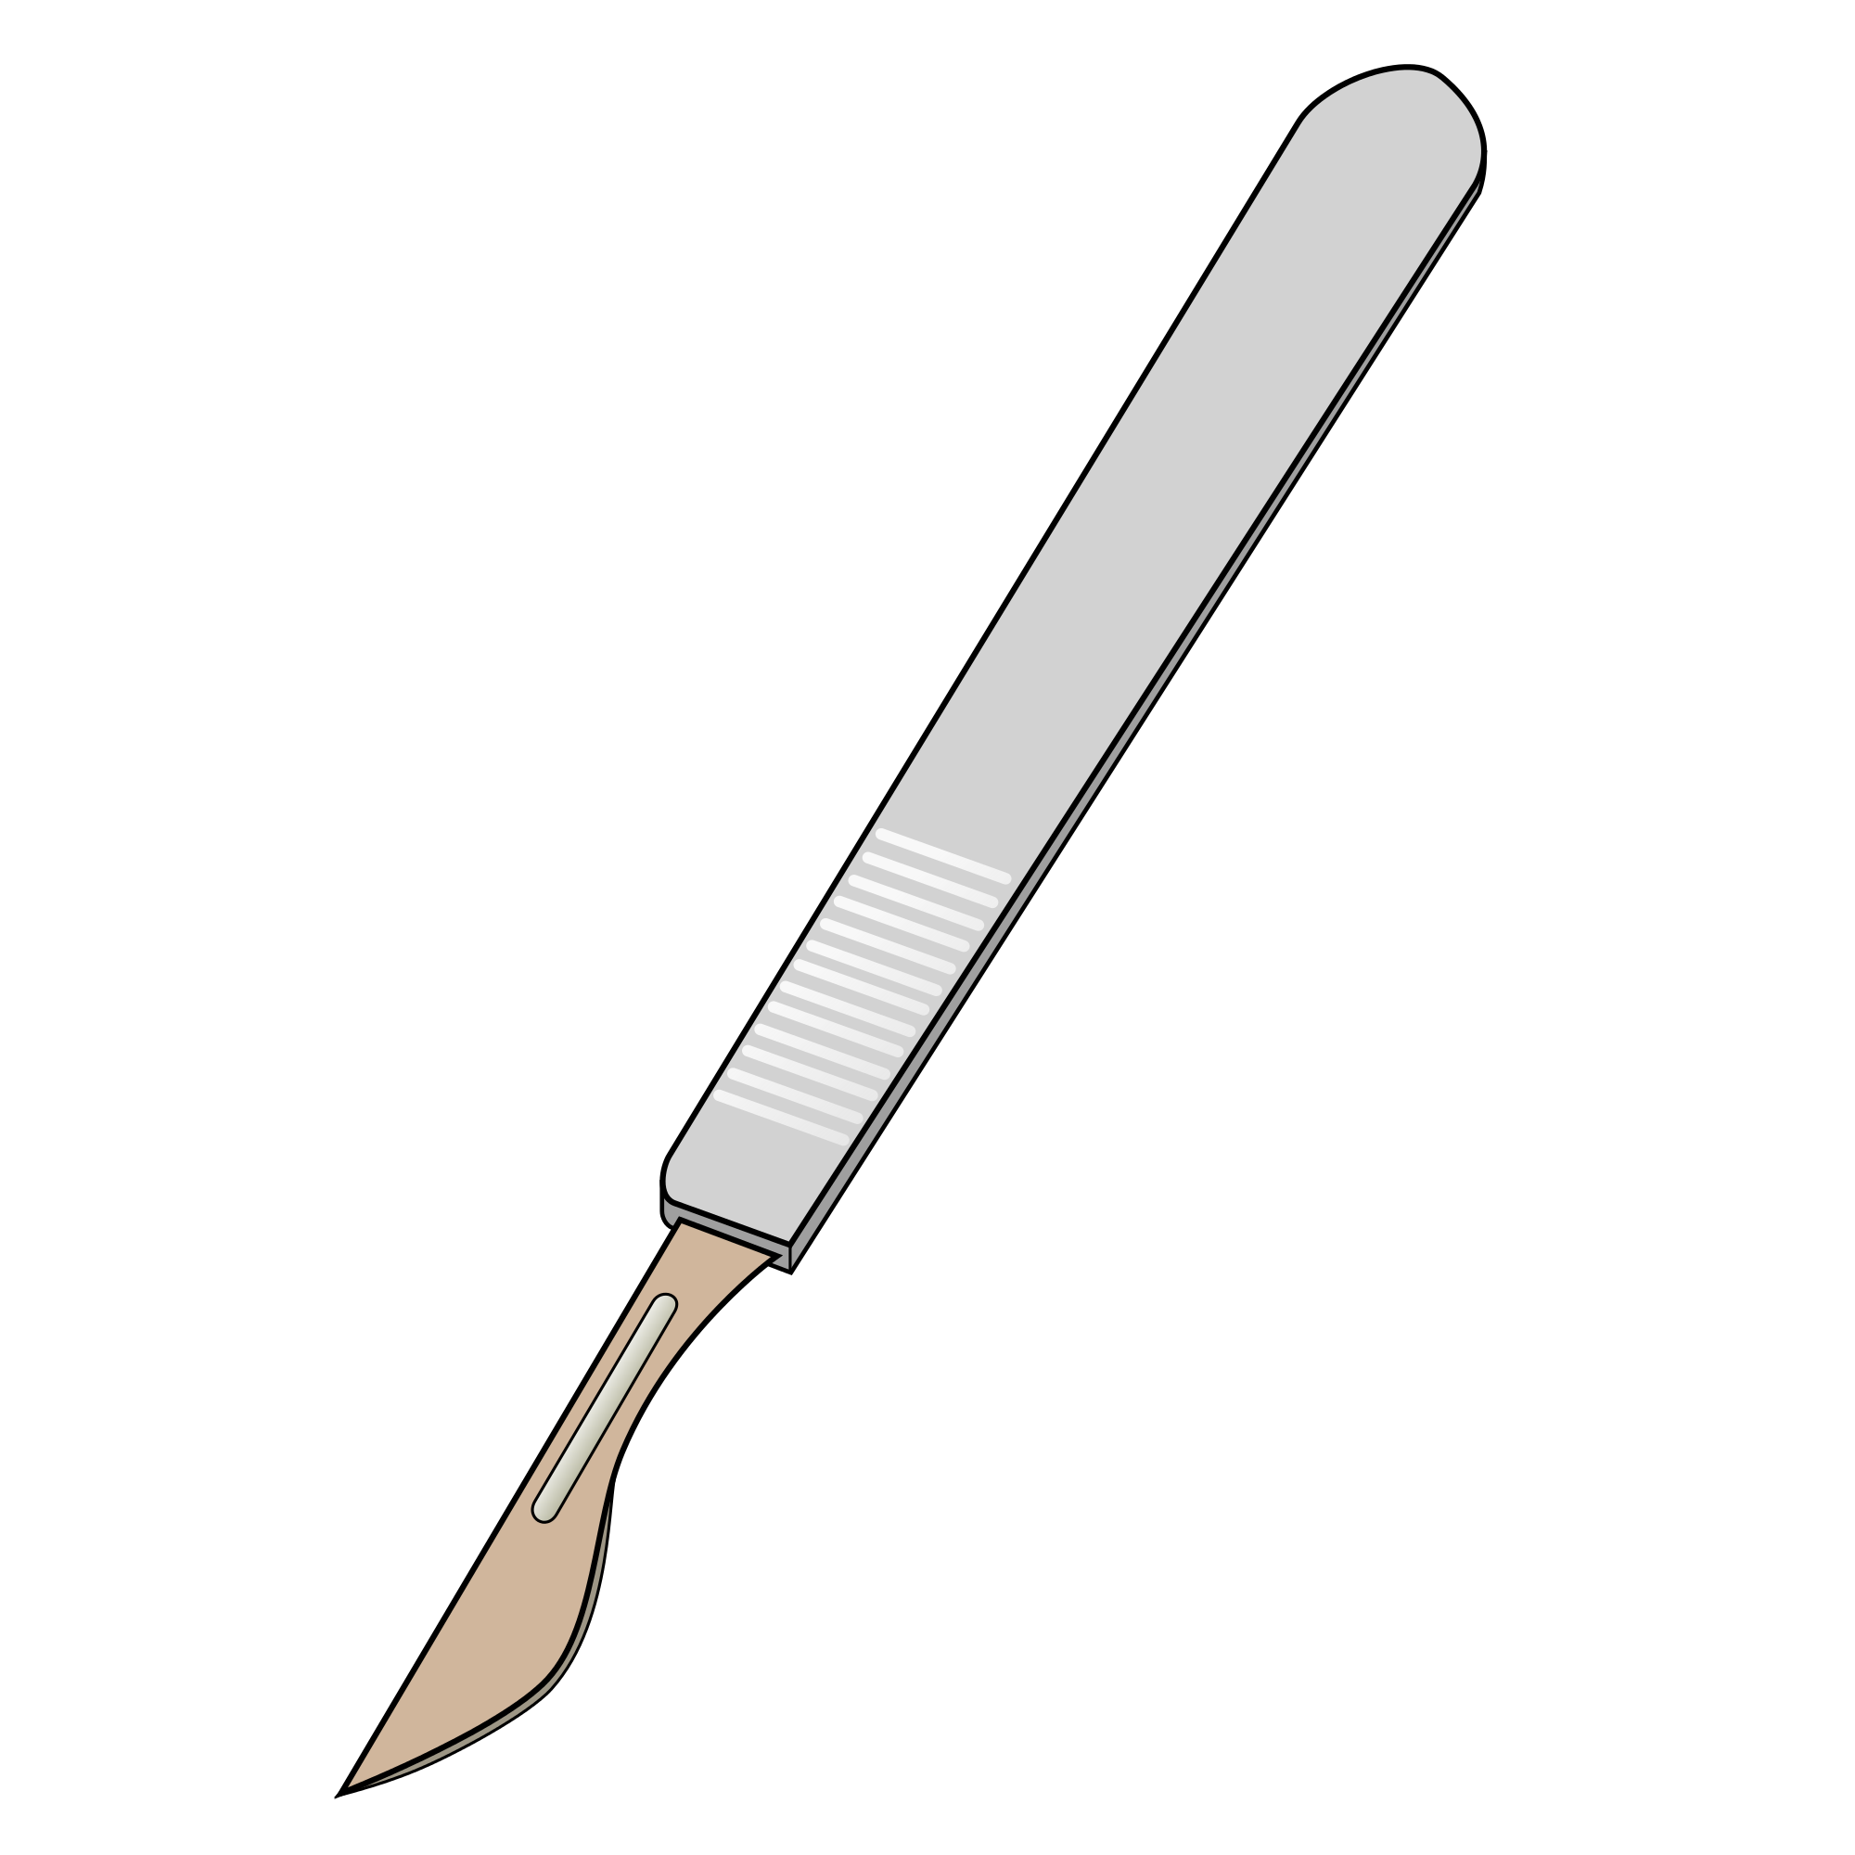
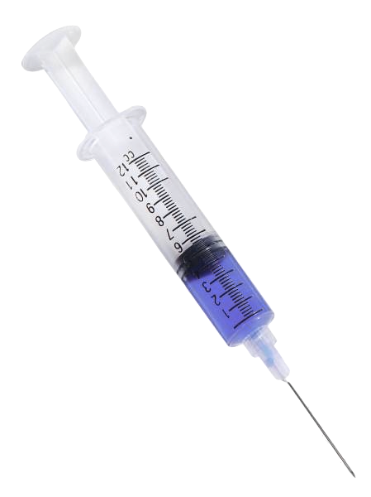
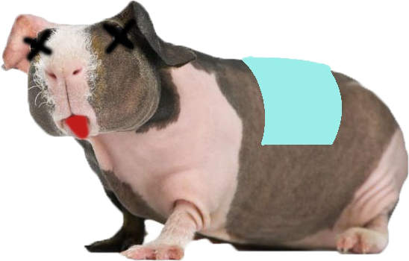
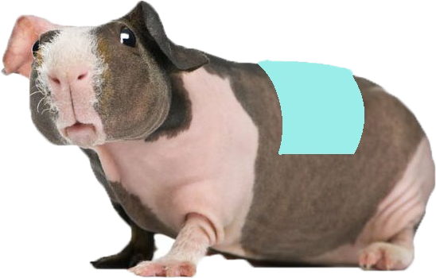
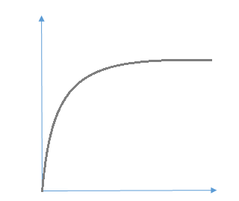
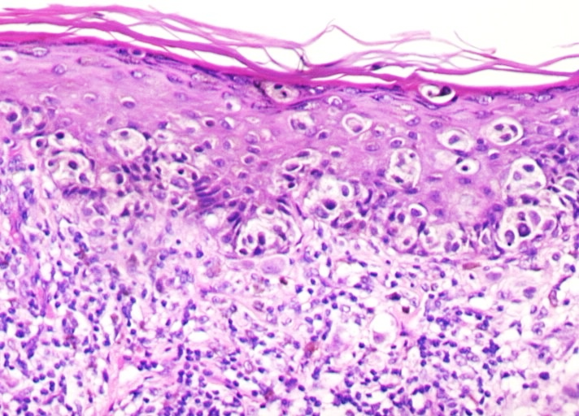
Testing: In vivo
Inject C32 melanoma cells into hairless guinea pig (HGP), remove most of tumor
Adhesion of Hydro-Bandaid to excision site
Drug release study from examining concentration in blood
Histopathology
Inflammation
Vascularization
Fibrosis
skin sample
Notes:
Fast then anesthetize, place patch, wrap with Vetwrap.
Primary skin irritation (PSI) index, sensitization

Slide 14
Summary
Wide-local excision surgery most common treatment for melanoma
Recovery can be extensive and long
Hydro-Bandaid offers controlled release of therapeutics to accelerate recovery and prevent recurrence at primary site
Future applications: controlled release of antibiotics and/or sterilization agents
-Topical postoperative infection control
-Steroid treatment
-Nicotine withdrawal remedy

